Slide 1

Housing Trends in Metro Atlanta
Presented by
Group 6 (Carnotaurus)
Bradley Barker
Yingying Li

Slide 2
Agenda
Background
Analysis
Conclusion
Way Forward

Slide 3
Background
Claim:
Null Hypothesis (H0) :
Alternate Hypothesis (Ha) :

Slide 4
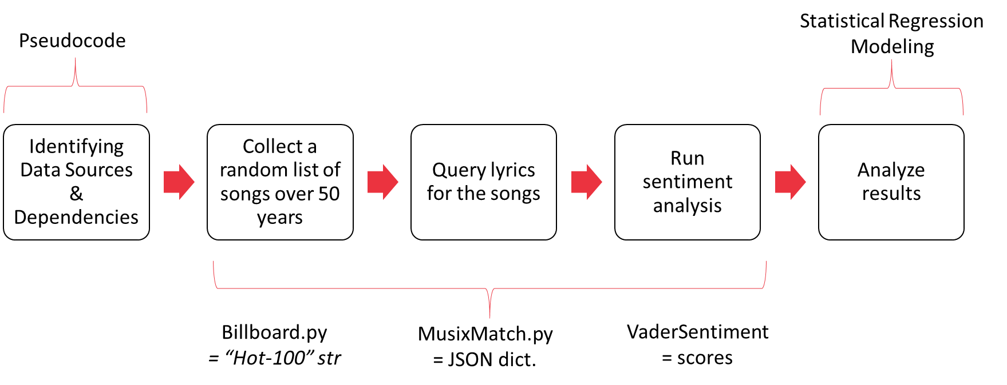
Approach

Slide 5
ANALYSIS

Slide 10
CONCLUSION

Slide 11
WAY FORWARD
Limitations & Considerations
Business Implications

Slide 12

Questions?

Slide 13
Appendix
Jupyter Notebook Snippets

Slide 14
Resources
Census Library
Zillow
Metro Atlanta Zipcode List

Slide 15
code

